Slide 1
Stat 495r – Presenting Data
Week 7 – R Markdown

Slide 2

Data Viz #1

Slide 3
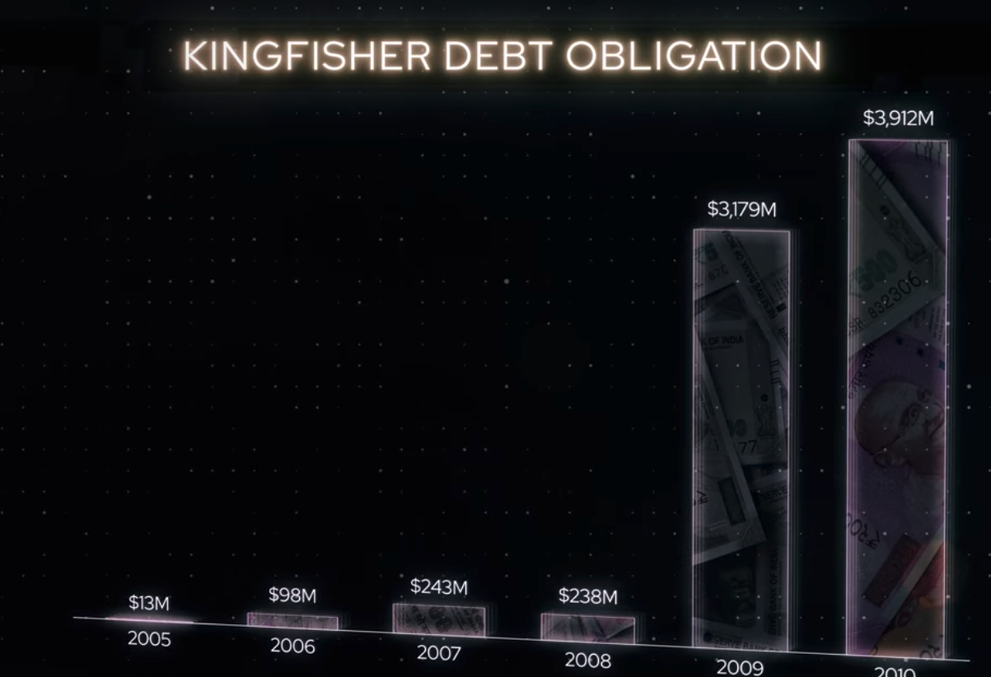
Data Viz #2

Slide 4
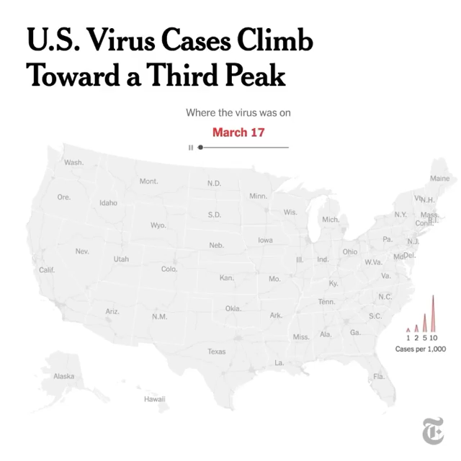
Data Viz #3

Slide 5
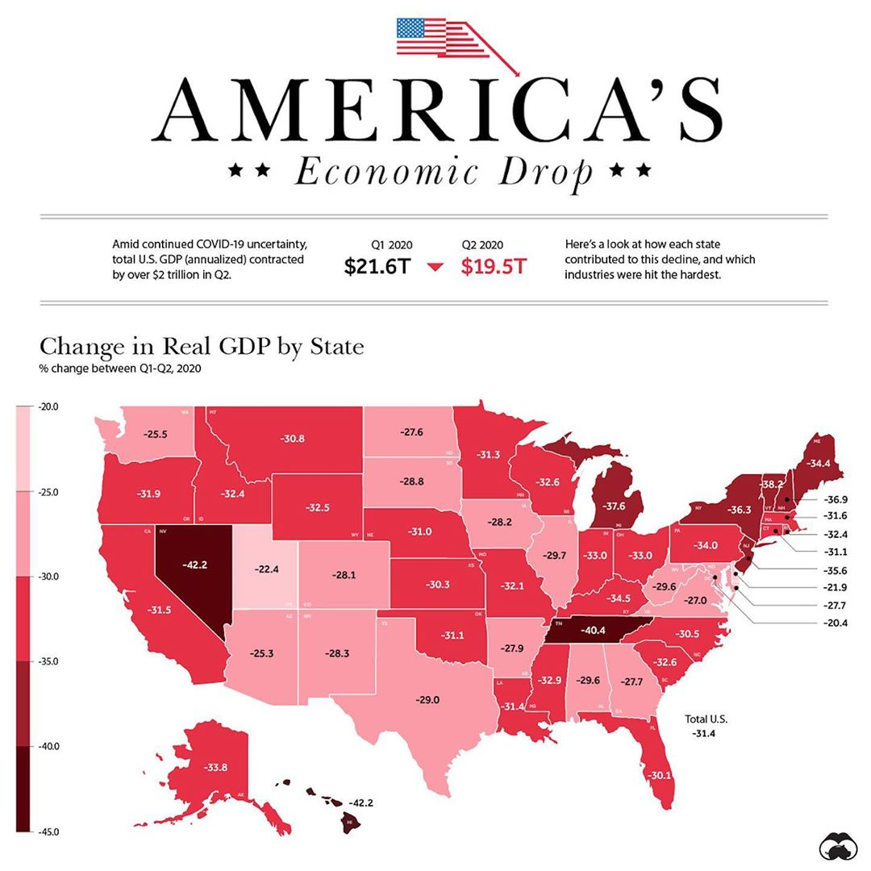
Data Viz #4

Slide 6

Quote of the Week
TBD

Slide 7
The number of employed has been increasing while the number of unemployed has been stead (but seasonal)
Total Population Across Time
In Thousands; Broken out by Employed and Unemployed
Employed
Population in Thousands
Unemployed
2294
2358
Star Date
Notes:
The number of unemployed people is actually very stable. It’s the increasing number of employed people that are causing the unemployment rate to decrease. The unemployment rate is also very seasonal, due to fluctuations in the unemployed people.

Slide 8
The unemployment rate is highly seasonal and has a strong downward trend
Unemployment Rate Across Time
With the Ideal Employment Rate*
Unemployment Rate
Seasonality
Trend
2294
2358
Star Date
Notes:
The number of unemployed people is actually very stable. It’s the increasing number of employed people that are causing the unemployment rate to decrease. The unemployment rate is also very seasonal, due to fluctuations in the unemployed people.

Slide 9
Controlling for seasonality and trend of unemployment reveals the effects of different party presidents is mostly random
Yearly Unemployment Rate
Adjusted to Remove Seasonality and Trend
Romulan Pres.
Klingon Pres.
Adjusted Unemployment Rate
2298
2358
Star Date
Notes:
However, “cherry-picking” dates is really biased. 1) The unemployment rate is highly seasonal and Klingon’s came into power and go out of power in very favorable years. 2) The policies of different parties have spill-over effects which bleed into other parties power. Klingons come into power when the unemployment is already on a downward trend. So when we remove the trend and seasonality only most random noise is left. Neither party actually affects the unemployment rate.

Slide 10


Klingons = Republicans Romulans = Democrats

Slide 11
Controlling for seasonality and trend, Republican governments decrease slightly more
Average Year-over-Year Unemployment Rate Delta by Government Branch
Controlling for 5-year seasonality by taking a 5-year moving average
President
Senate
House
Democrat
Democrat
Democrat
Unemployment Rate Delta
Unemployment Rate Delta
Unemployment Rate Delta
Republican
Republican
Republican
Notes:
However, as mentioned the unemployment rate is highly seasonal. So when we control for the seasonality by taking a 5-year moving average, Romulans actually do more to push the unemployment rate down. We have average the year-to-year change (delta) for all three government branches.

Slide 12
Democrats always had a better unemployment rate when in power
Average Yearly Unemployment Rate By Different Party Power Combinations
Democrats control all 3 branches: Unemployment Rate = 4%
Republicans control all 3 branches: Unemployment Rate = 8%
House | D | D | D | D | R | R | R
President | D | D | R | R | D | D | R
Senate | D | R | D | R | D | R | R

Slide 13
Over the 4 year terms, the unemployment rate drops more Democratic presidencies
Unemployment Rate Over Time
Unemployment Rate Delta Coming into Presidency to Last Year
Average Unemployment Rate
Change in Unemployment Rate
Dem
Rep
2298
2358
Presidency Start Year
Star Date
Notes:
Here is an example of how we calculated the delta from the first year of a presidency to the last year. As you can see, in truth we were “cherry-picking” years.

Slide 14
Publishing using GitHub
Just prepend this to the URL
http://htmlpreview.github.io/?https://github.com/jeffreyxparker/stat495rFall2020/blob/master/Syllabus.html

Slide 15
Other R Markdown Formats

Slide 16
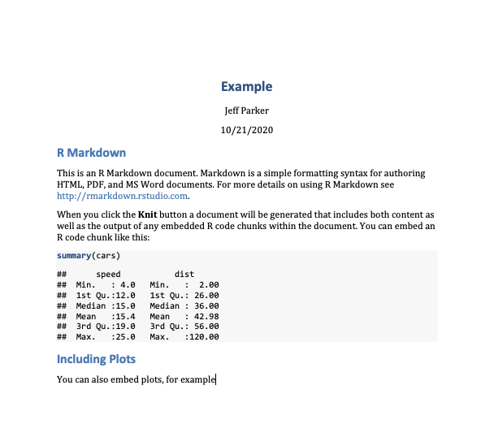
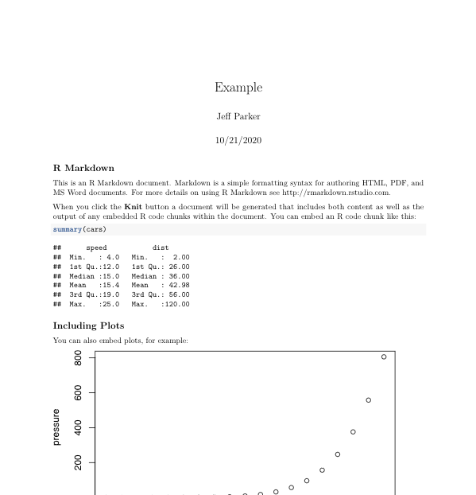
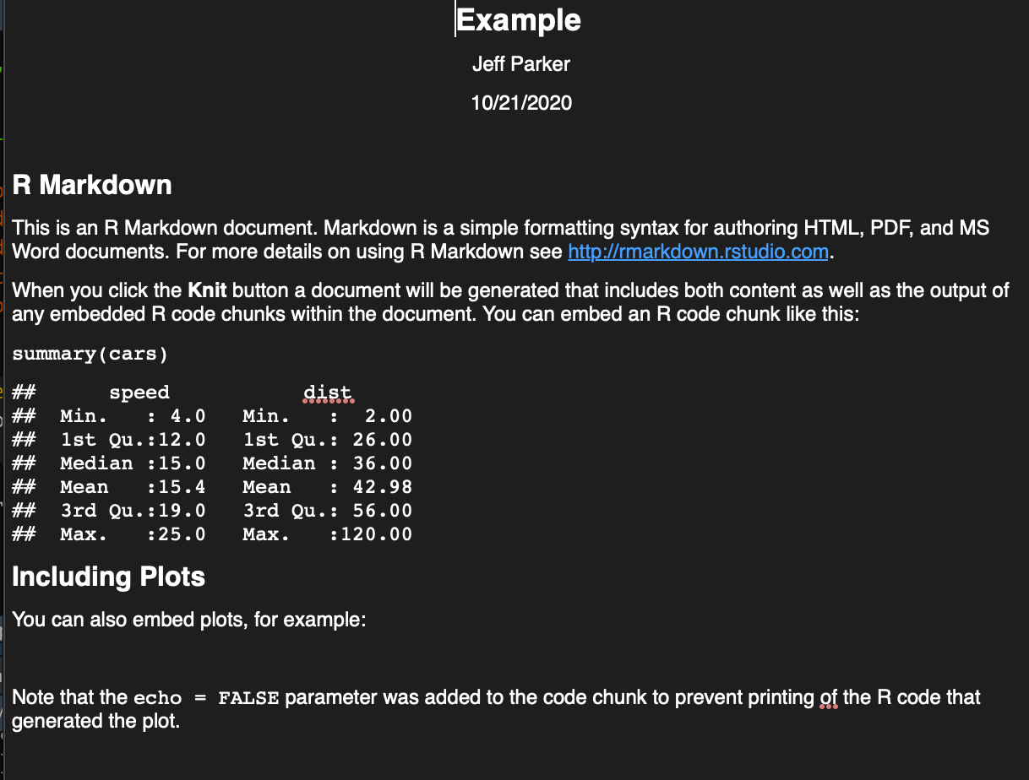
Documents
MS Word
PDF
RTF
AND MORE!!!

Slide 17
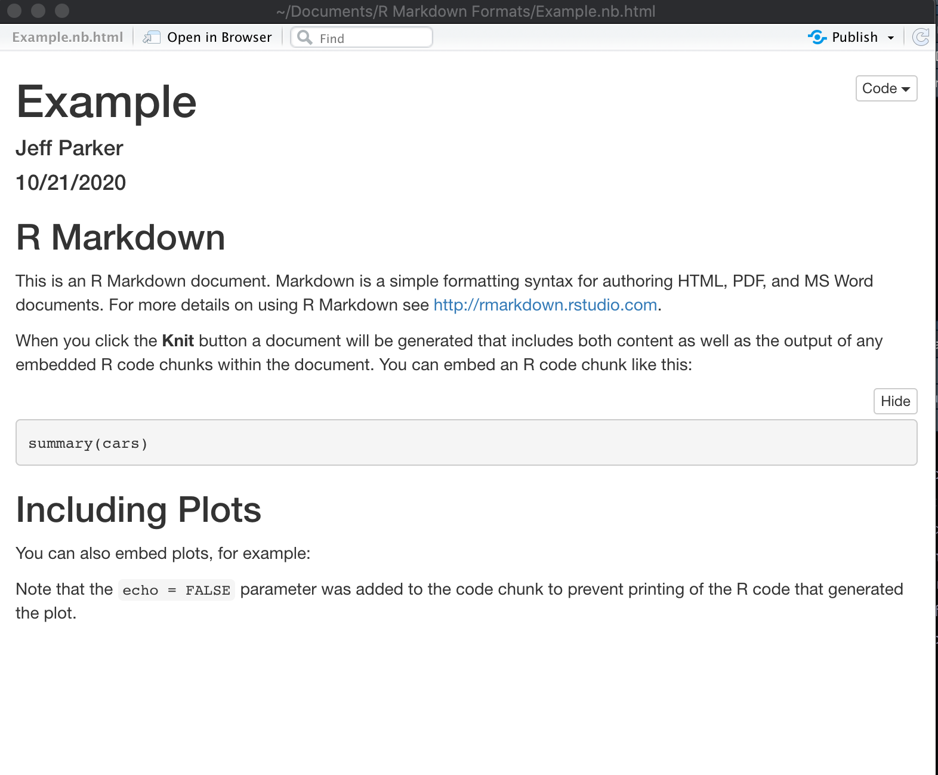
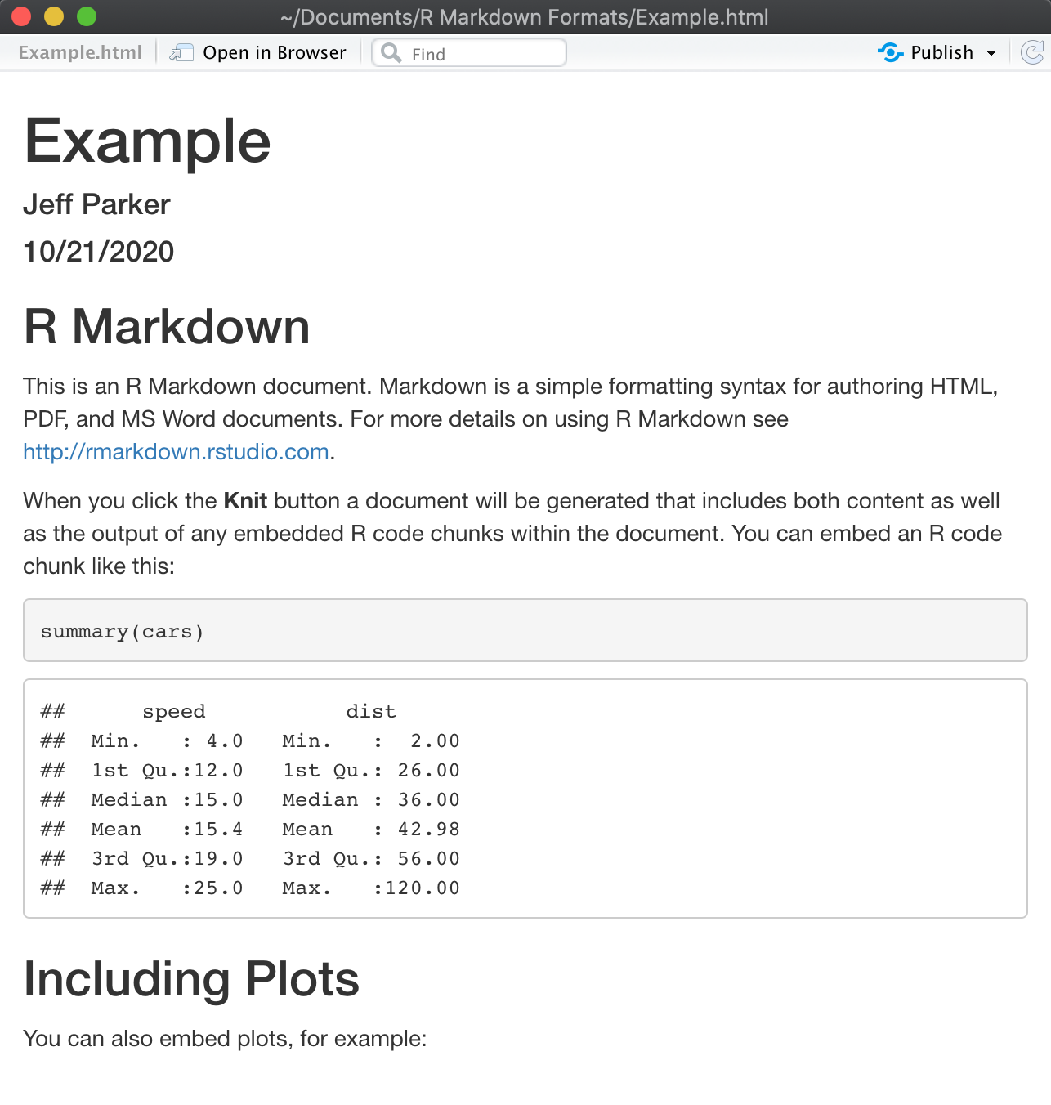
Notebooks
Notebook
HTML Document
For Data Scientists
For Business Leaders
Notes:
Change the YAML Headers and see what happens

Slide 18
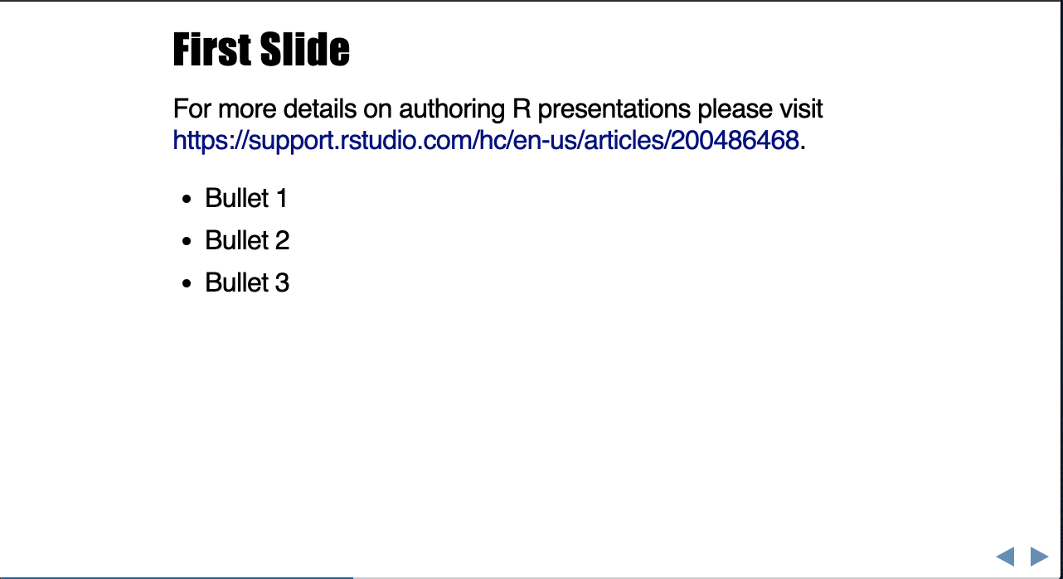
Presentations
Less visual control than Keynote or PowerPoint, but automatically inserting results of R code can be a huge time saver – stay tuned though for how to automate PowerPoint

Slide 19
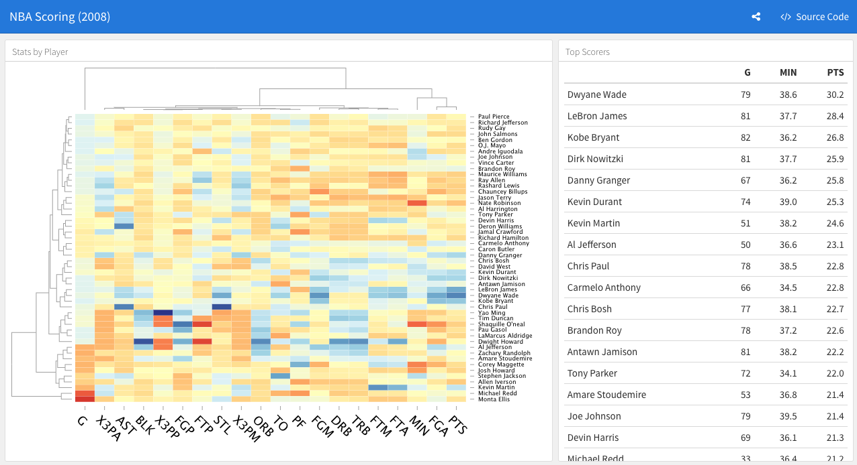
Dashboards
install.packages("flexdashboard")
Full day of RShiny forthcoming

Slide 20
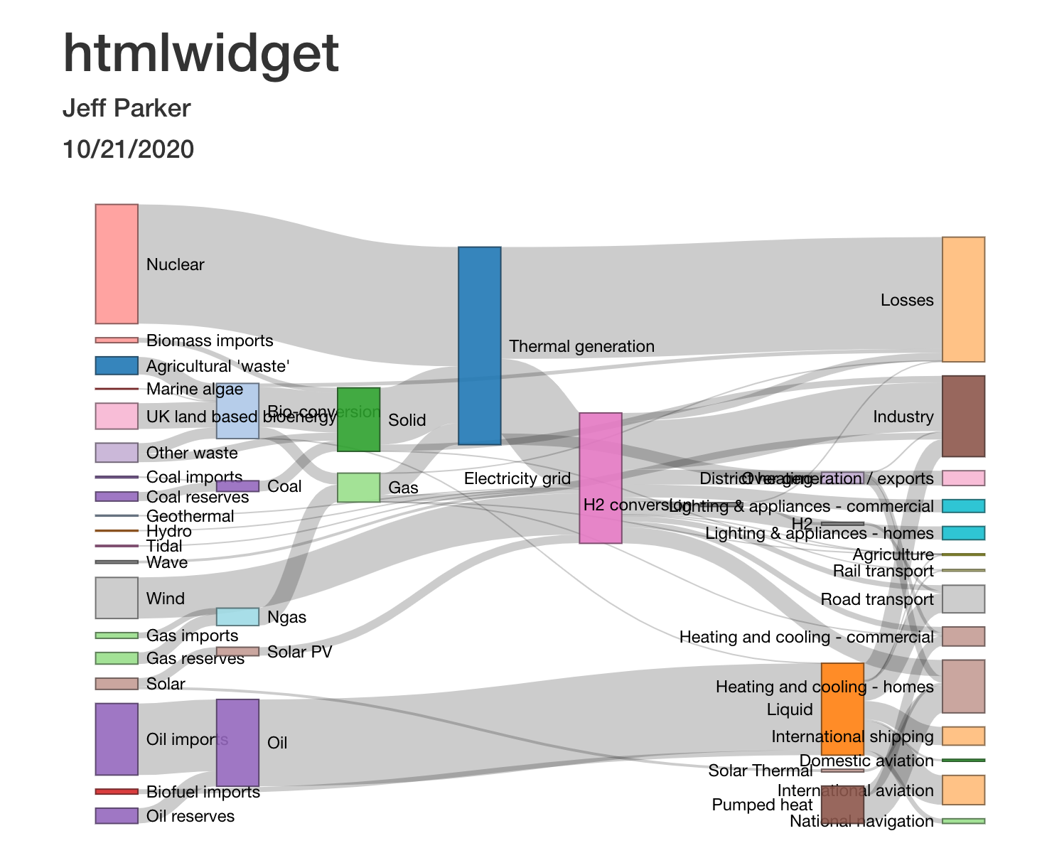
htmlwidget
Full day of htmlwidgets forthcoming

Slide 21
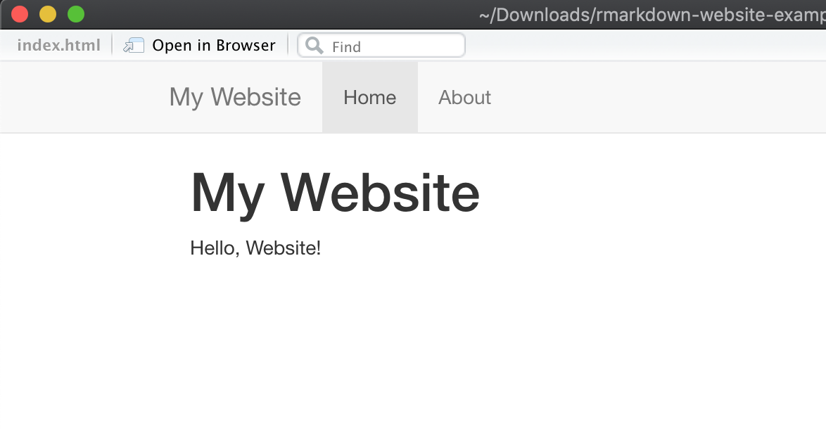
Websites
Flex dashboards is a type of website
Other more advanced website generation exists through Bookdown

Slide 22
Demonstration

Slide 23
Making and publishing a website

Slide 24
Homework

Slide 25
Homework 1
Deseret News has provided us with graphics that could use some improvement
You have been randomly assigned to one of the graphics
Using the data from the graphic make a better visual that more clearly communicates the data story for the reader audience:
Remove chart junk elements
Consider new chart types
Use colors strategically
Have a bold, punchy headline
Consider the ink-to-data ratio (or the ink-to-insight ratio)
Newspapers tend to prefer more vertical graphics than horizontal graphics
Make a website or flexdashboard with 2 pages, the original and your improved version
If you are a Tableau user, do NOT use Tableau; if you are matplotlib user, do NOT use Python
Deseret News has requested we send them the improved graphics

Slide 26
HW1 Assignments
Student | Graphic Assignment
Zach | Remote WorkWins-01.jpg
Annie | 0913P2graphic-01.jpg
Parker | Trump August poll2-01.jpg
Jenny Beth | Run-off poll-01.jpg
Kolby | Trump August poll-01.jpg
Kylee | 0906P2graphic-01.jpg
Kate | vaccinedistribution2-02.jpg
Matt | 0906P2graphic-01.jpg
Back-up | 0823P2graphic-01.jpg
Back-up | august heat-02.jpg

